Slide 1
Data Analysis
Roll Forward Rates
-
- Roll rate for TBO loans in March: 60.9%
Roll rate for TB0 loans in April: 67.1%
Roll rate for TB0 loans in May: 72.1%
Roll rate for March TB0 loans: 1.591%
Roll rate for April TB0 loans: 1.998%
Roll rate for May TB0 loans: 1.556%
Principal Balance Roll forward rate:
Total sanctioned amount: 1862351670144
Balance roll rate for TB0 loans in March: 44.4 %
Balance roll rate for TB0 loans in April: 48.56 %
Balance roll rate for TB0 loans in May: 53.39 %
 | Roll Forward Rate | Principal Balance Roll Forward | Principal Balance Roll Forward Rate
MONTH
March | 60.921 | $ 827,728,346,975.54 | 44.445
April | 67.129 | $ 904,446,972,331.73 | 48.565
May | 72.176 | $ 994,376,841,007.47 | 53.394

Slide 2
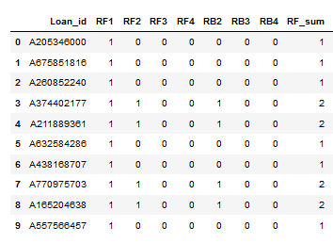
Data Analysis
QC Checks & Issues
Call Data Analysis
 | Average Intensity | Average RPC Rate | Average PTP Rate
MONTH
March | 12.958 | 0.495 | 0.237
April | 11.248 | 0.485 | 0.218
May | 10.963 | 0.497 | 0.215
 |  | No. of Months | RPC | PTP | Total Contacts | RPC rate | PTP rate | Perf Metric
TOP 5 | Login_ID
 | AGNT91 | 2 | 7 | 2 | 7 | 1.000 | 0.287 | 0.584
 | AGNT58 | 1 | 2 | 1 | 2 | 1.000 | 0.505 | 0.515
 | AGNT79 | 2 | 9 | 8 | 17 | 0.529 | 0.471 | 0.508
 | AGNT80 | 2 | 9 | 2 | 9 | 1.000 | 0.223 | 0.456
 | AGNT71 | 1 | 4 | 4 | 6 | 0.667 | 0.668 | 0.456
BOTTOM 5 | Login_ID
 | AGNT68 | 2 | 81 | 0 | 81 | 1.000 | 0.000 | 0.010
 | AGNT75 | 1 | 13 | 0 | 14 | 0.929 | 0.001 | 0.011
 | AGNT104 | 1 | 12 | 0 | 12 | 1.000 | 0.001 | 0.011
 | AGNT51 | 1 | 7 | 0 | 7 | 1.000 | 0.001 | 0.011
 | AGNT83 | 3 | 9 | 0 | 9 | 1.000 | 0.001 | 0.013
Correlation between principal balance and term: -0.551402
If we estimate the absolute correlation value as being moderate if it falls between 0.5 and 0.7, we can conclude that there is a moderate correlation between term completed and principal balance. In addition as this is a negative value, we conclude that this is a negative relationship, meaning as there is an increase in one variable there is a decrease in the other and vice-versa.

Slide 3
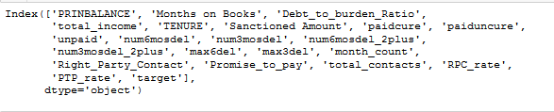
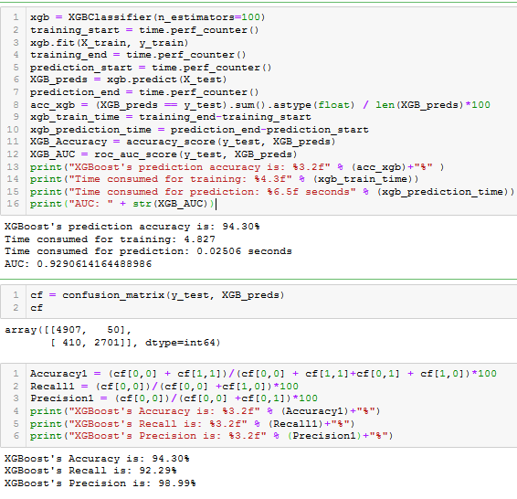
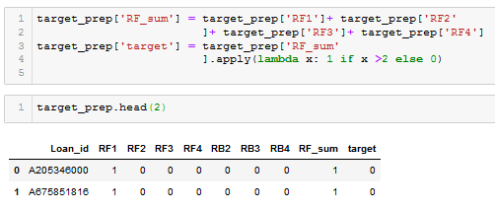
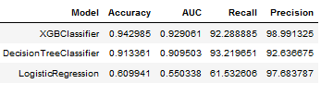
Prediction Model
XGB Classifier
Features
Target
LR & DT Result Comparison

Slide 4
Post Mortem
Dataset Limitations and Issues
Key Observations
School District analysis presented several challenges:
Matching School Districts to Neighborhoods proved to be time consuming, with school District Boundaries have changed over time...
The school district does not represent educational value, some rich families send their children to private schools instead...
Our team only included middle and elementary school ratings because of the high school system in New York…
Locational features within the dataset are possibly interdependent presenting challenges for regression:
School Districts, Neighborhoods and Zip Code features are essentially subsets of each other...
Possibly requires feature engineering to effectively incorporate locational variables while addressing multicollinearity and heteroskedasticity...
Large Datasets are a blessing and a curse:
With 111 features and large number of observations the data presented tremendous analytical and predictive opportunities...
The process of identifying and zoning into manageable chunks of information was time consuming and tedious...
With several interdependencies and overlaps, the right answer to many a question was usually another bigger question...
Visualizations are useful in quickly identifying trends which may otherwise take longer / be difficult to verify/validate:
Scatter plot visualization point to a clear trend in neighbourhoods closer to manhattan being more expensive..
Box plots enabled comparison of locational variables across the board allowing identification of school districts as focus variable for analysis
Interpreting and calibrating regressions/ML models to produce meaningful outputs is perhaps the real challenge :
R Squared is not the only variable to be focused on...
Understanding and keeping track how results relate to the changes in inputs requires discipline and experience

Slide 5
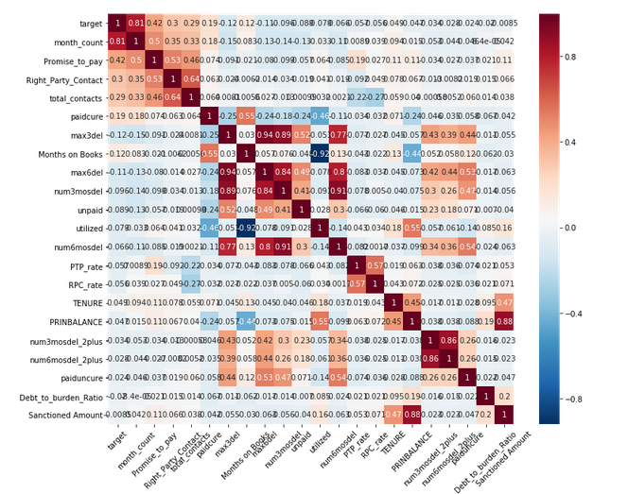
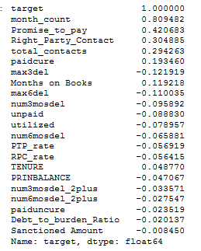
Appendix: Additional Discussion Materials
Correlation Heat Map

